Slide 1


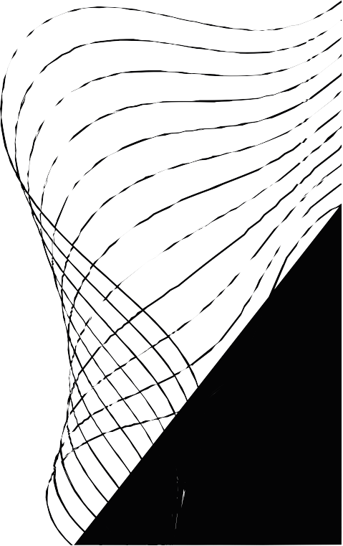
PRIVACY PRESERVATION IN DIGITAL CONTENT THROUGH COMPUTER VISION:
FACE, TEXT, AND LOGO BLURRING

Slide 2



OUR TEAM
Sufyan Imran
k20-0386
Group Leader
Abdeali k20-0122
Group Memeber
Aun Ali k20-0286
Abdeali
Ahmed Jamil
oup Member
Gr
Group Member

Slide 3


CONTENT
01
02
03
04
INTRODUCTION
METHADOLOGY
IRESULTS AND DISCUSSION
CONCLUSION

Slide 4

INTRODUCTION
Introducing high- end technologies in Traditional Cars

Slide 5


THE NEED FOR PRIVACY PROTECTION IN DIGITAL MEDIA
Importance of privacy in today's digital age
The need for automatic privacy protection in digital content Objective of the FCV Project: To design a system that can blur faces, sensitive text, and logos in videos and documents

Slide 6


METHODOLOGY

Slide 7


METHODOLOGIES EMPLOYED IN THE FCV PROJECT
Use of res 10_300x 300_ssd_iter_140000. caffemodel for face detection and blurring in videos
Use of pytesseract_OCR for detecting and blurring sensitive text in documents
Application of Open CV' s template matching for brand logo
detection and blurring in videos

Slide 8

RESULTS AND DISCUSSION

Slide 9


ANALYSIS OF OUTCOMES AND POTENTIAL IMPROVEMENTS
Presentation of the results from each use case
Discussion on the effectiveness of the methods used and the challenges faced during the project
Potential improvements and future enhancements for each
use case

Slide 10
PROJECT SUMMARY AND FORWARD- LOOKING STATEMENTS
Recap of the project' s objectives and outcomes
The FCV Project' s contribution to privacy protection in digital content
Future directions: Potential for expansion to other areas of
privacy protection, such as l icense plate blurring or voice data anonymization

